Slide 1
Vulnerability to climate change for water resources, agriculture and health in the Indian part of the Ganges basin HIGHNOON: Adaptation to changing water resources availability in Northern India with Himalayan glacier retreat and changing monsoon
Eddy Moors and the HighNoon team
Climate Change and Adaptive Land & Water Management
Alterra - Wageningen University and Research Centre, The Netherlands
www.ess.wur.nl
www.eu-highnoon.org
Partners: Alterra Wageningen UR, TERI, IITD, IITK, Uni. Nagoya, Met Office, Max Planck Institute, Uni. Geneva, Uni Salford

Slide 2
Adaptation to changing water resources availability in Northern India with Himalayan glacier retreat and changing monsoon
water availability
water demand

Slide 3
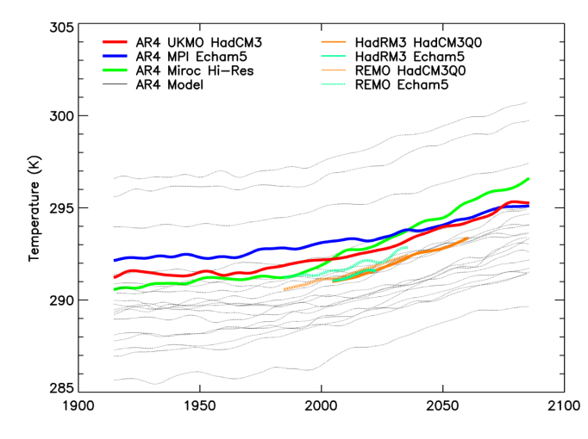
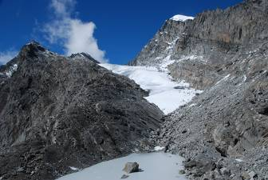
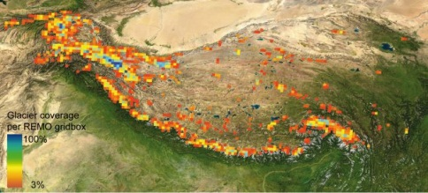
Adaptation to changing water resources availability in Northern India with Himalayan glacier retreat and changing monsoon
Glacier/snow contribution
Climate projections
water availability
water demand

Slide 4
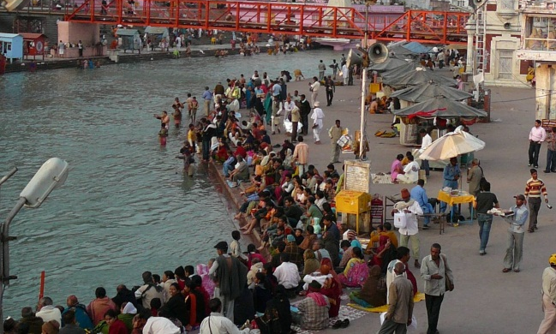
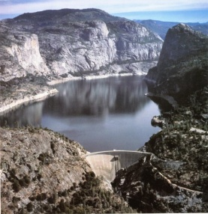
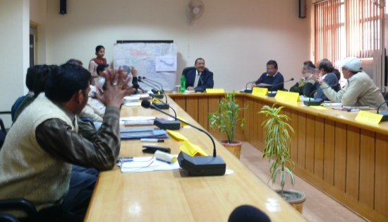
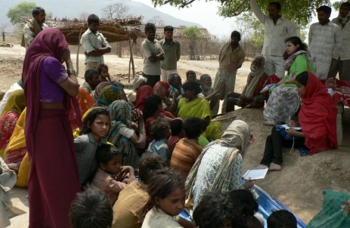
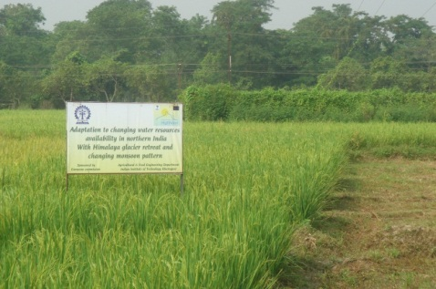
Adaptation to changing water resources availability in Northern India with Himalayan glacier retreat and changing monsoon
Glacier/snow contribution
Climate projections
water availability
Water demand & distribution
Stakeholder participation
water demand

Slide 5
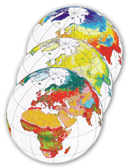
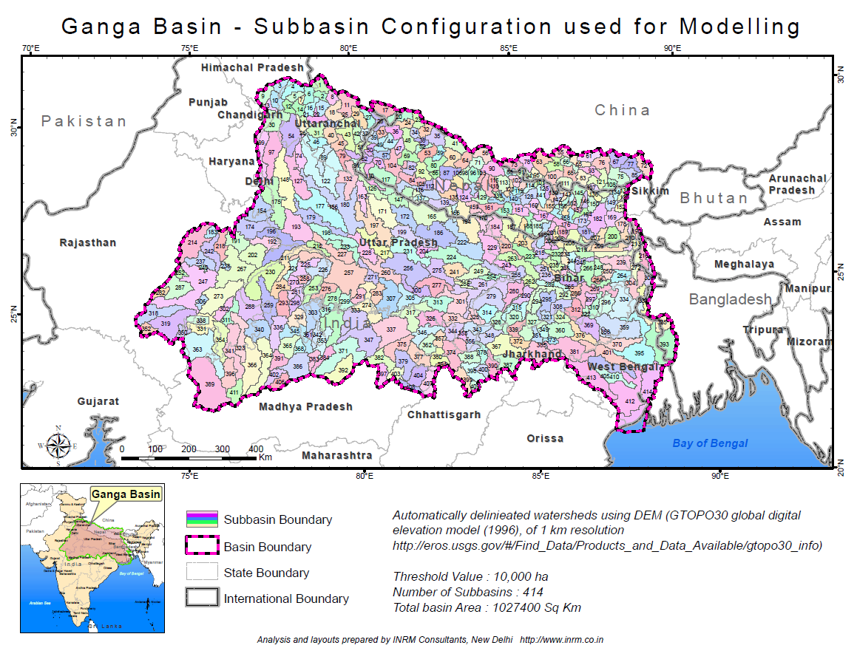
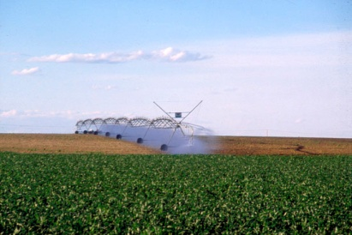
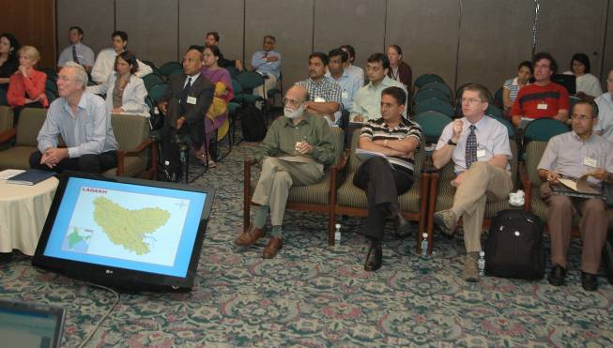
HighNoon Approach
Downscaling of socio economic scenarios
Evaluation of impacts
Informing
Water demand
Water availability
Prioritization
Set of adaptation options
Informing

Slide 6
Inter-comparison RCM’s focused on Monsoon
Participating RCM model runs (0.25 x 0.25 resolution):
ECHAM – REMO
HADCM3 – REMO
ECHAM – PRECIS
HADCM3 – PRECIS
Contact: Andy Wiltshire via HighNoon web site

Slide 7
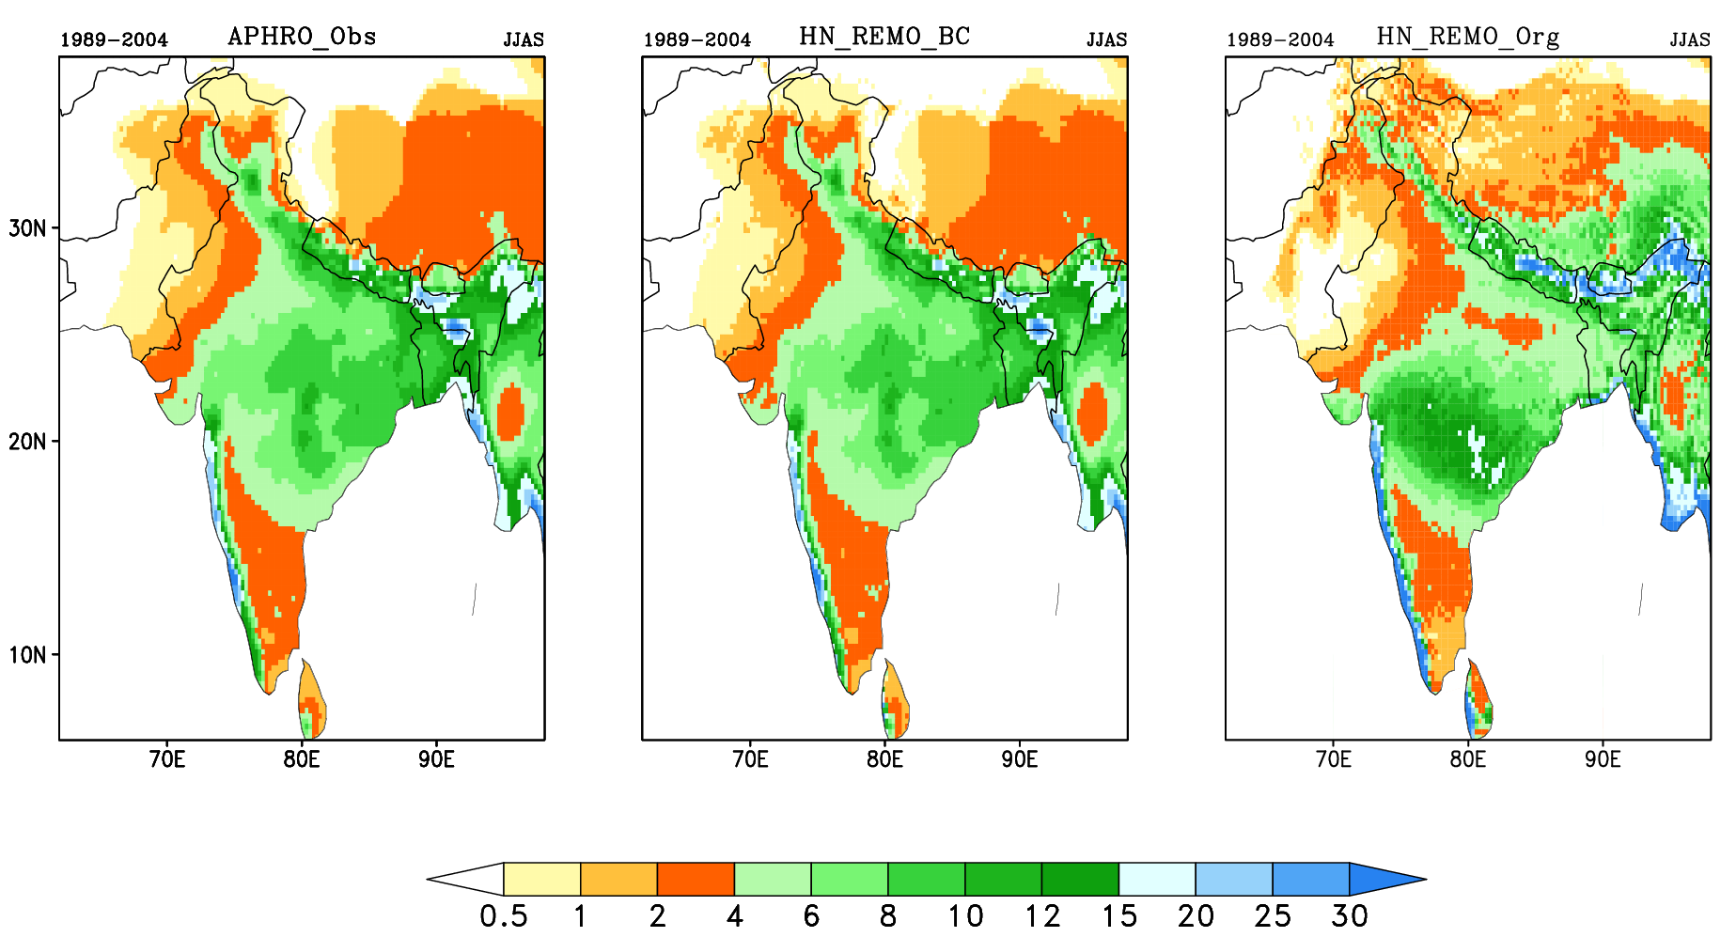
Bias correction for precipitation
(Kumar et al. 2013. Online on Science of the total environment)

Slide 8
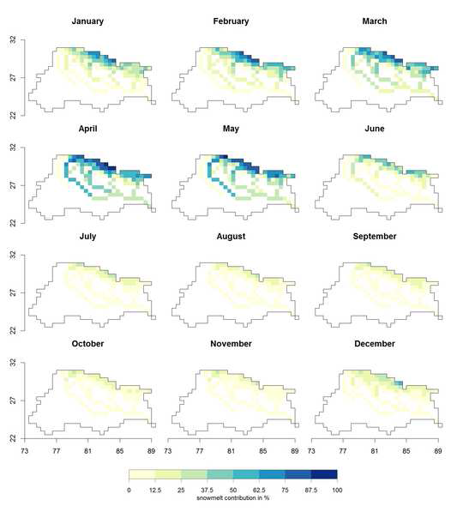
Water resources
(Siderius et al. 2013. Science of the total environment Online)

Slide 9
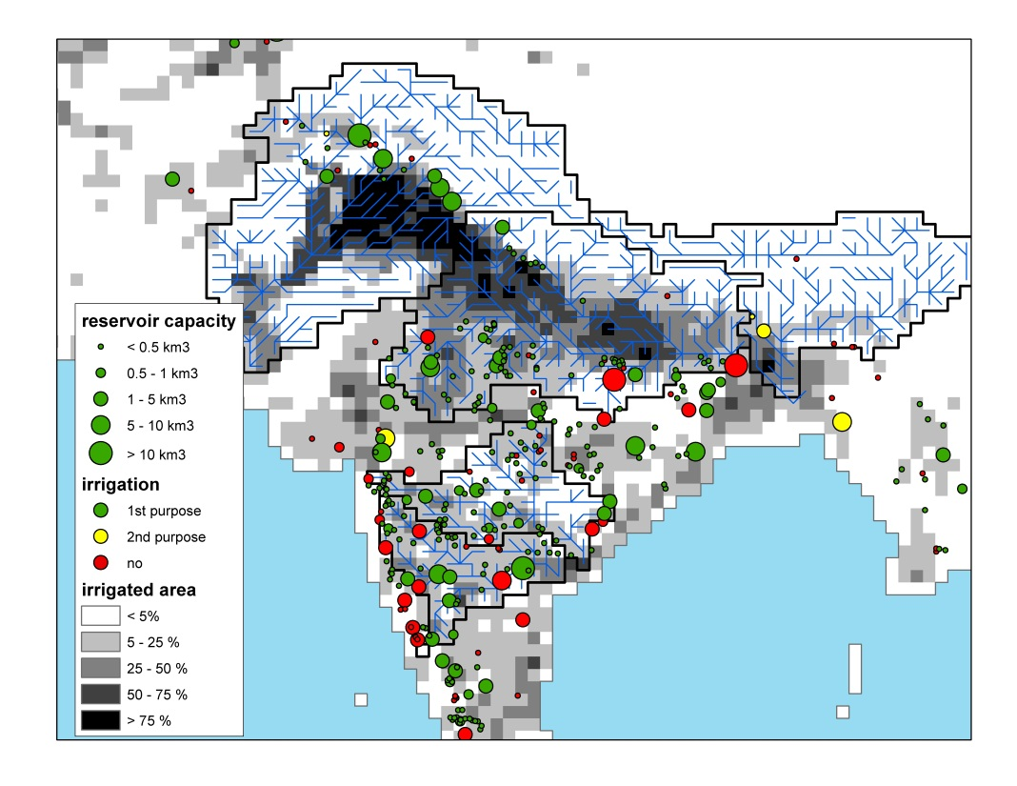
Agriculture: Food security & water demand
Rice: decrease in production in 2050 varying between 20 to 40% depending on RCM used!
(Biemans et al., 2013 & Mishra et al., 2013. Science of the total environment, Online)

Slide 10
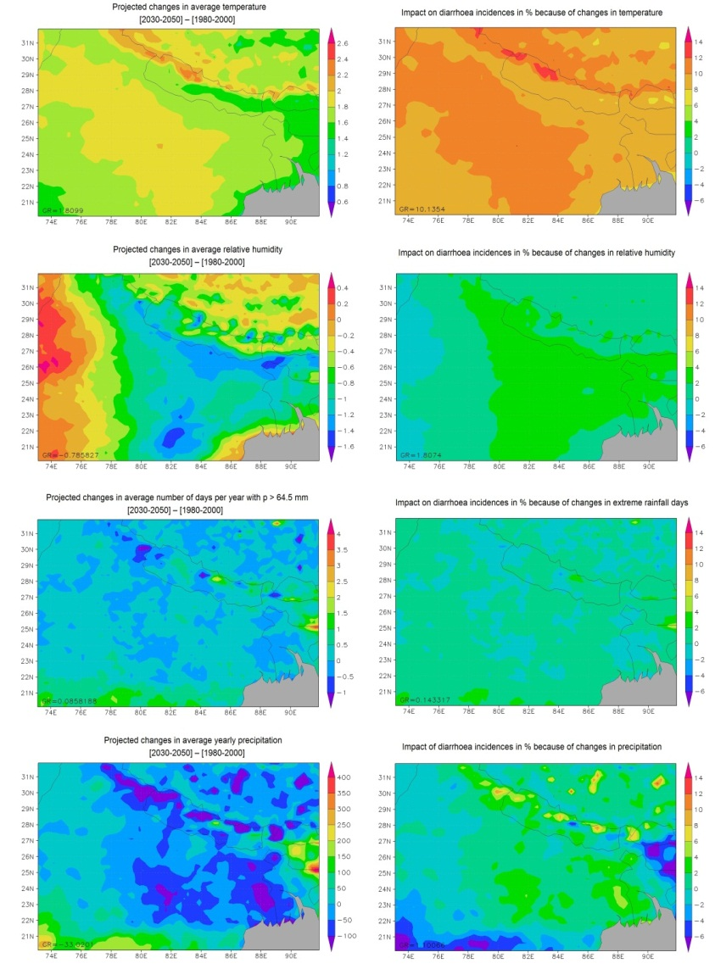
Health: Effect of climate factors on diarrhoea incidences
Change in climate
(2030-2050) - (1980 – 2000)
Change in impacts
%
Temperature
Relative humidity
Number of days per year with P > 65 mm
Yearly precipitation
(Moors et al. 2013. Science of the total environment, Online)
Notes:
Climate change impact on all-cause diarrhoea for all climate factors (projected changes for each climate factor on the left side. On the right side of the image you can see the impact of the changes in these climate factors on diarrhoea incidences)

Slide 11
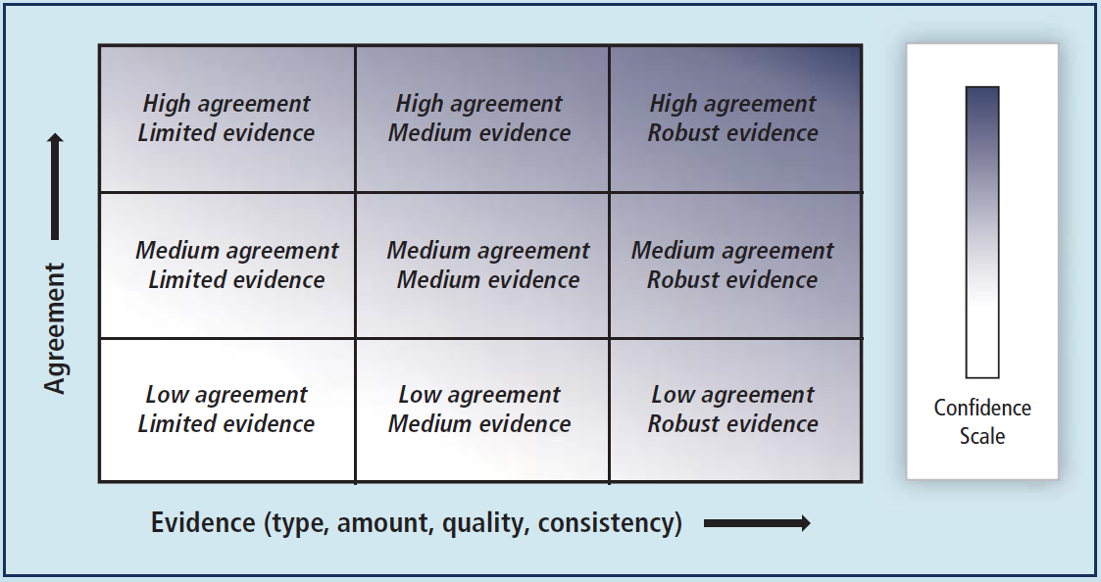
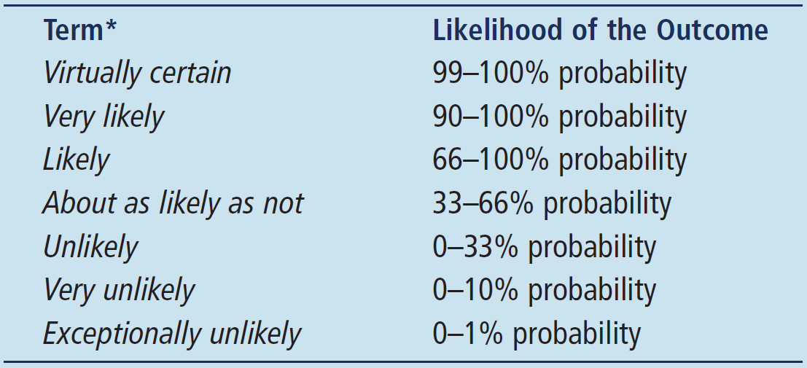
Communication: Common language
What is the definition of risk?

Slide 12
Summary
Communication of uncertainty/variability and robust evidence
Bias corrections
Ensemble model predictions

Slide 13
Thank you for your attention
See for info: www.eu-highnoon.org
Contact: Eddy.Moors@wur.nl
Overview paper:
Moors et al., 2011. Adaptation to changing water resources of the Ganges basin in northern India. Ecology and policy, 14: 758-769
HighNoon special issue “Changing water resources availability in Northern India with respect to Himalayan glacier retreat and changing monsoon patterns: consequences and adaptation” in Science of the Total Environment forthcoming end of 2013

